Slide 1
Introduction to Quantum Computing: From a Layperson to a Programmer in 30 Steps
Hiu-Yung Wong
https://link.springer.com/book/10.1007/978-3-030-98339-0
https://www.amazon.com/Introduction-Quantum-Computing-Layperson-Programmer/dp/3030983382
Playlist: https://www.youtube.com/watch?v=M9mAEQp0xhM&list=PLnK6MrIqGXsJfcBdppW3CKJ858zR8P4eP&index=32
https://www.youtube.com/watch?v=3_aHm92GqCU&list=PLnK6MrIqGXsJfcBdppW3CKJ858zR8P4eP&index=33
https://www.youtube.com/watch?v=sDg_EY2-ZVA&list=PLnK6MrIqGXsJfcBdppW3CKJ858zR8P4eP&index=31
https://www.youtube.com/watch?v=SoioJuODW8I&list=PLnK6MrIqGXsJfcBdppW3CKJ858zR8P4eP&index=34
https://www.youtube.com/watch?v=E9wd-1slbNo&list=PLnK6MrIqGXsJfcBdppW3CKJ858zR8P4eP&index=36

Slide 2


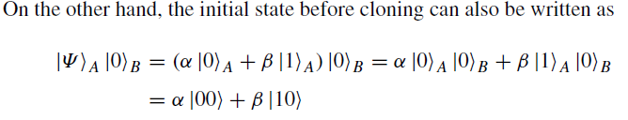
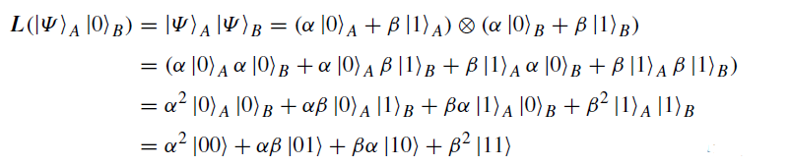
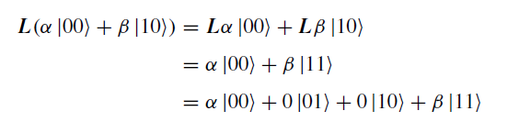
No-Cloning Theorem
Proof by contradiction
Let the cloning operator be L, which is an operator in the C4 space. We have
LHS Not equal to RHS
Therefore, it is possible to clone the basis states but NOT other superposition states.

Slide 3
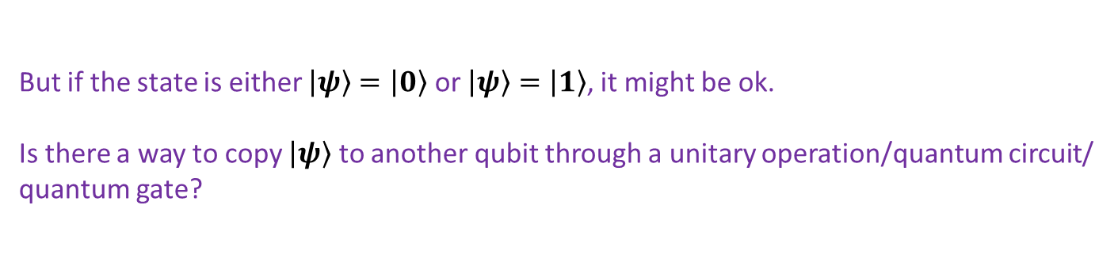





No-Cloning Theorem
We cannot copy by reading
$${\left|α\right|}^{2}$$
$$\left.\left|0\right.\right\rangle$$
$$\left.\left|ψ\right.\right\rangle =\left.α\left|0\right.\right\rangle \left.+β\left|1\right.\right\rangle$$
M
$$\left.\left|1\right.\right\rangle$$
$${\left|β\right|}^{2}$$
But if the state is either $\left.\left|ψ\right.\right\rangle =\left.\left|0\right.\right\rangle$ or $\left.\left|ψ\right.\right\rangle =\left.\left|1\right.\right\rangle$, it might be ok.
Is there a way to copy $\left.\left|ψ\right.\right\rangle$ to another qubit through a unitary operation/quantum circuit/ quantum gate?

Slide 4


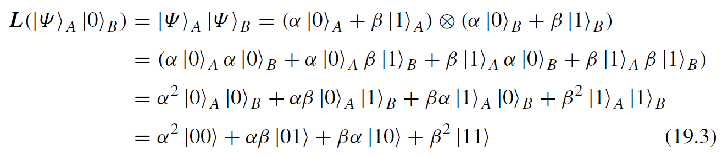
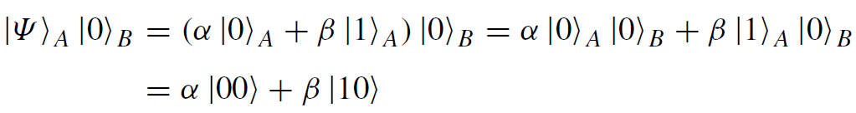
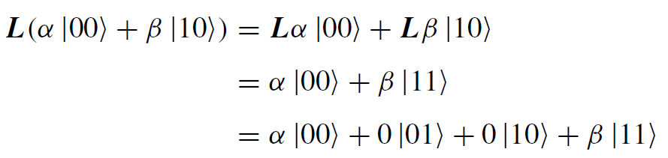
No-Cloning Theorem
Assume
Only basis states can be copied

Slide 5
Some notes
Some multiple qubits transformation cannot be expressed as a sequence of operations on single qubits.
A unitary transformation is called simple if n-2 qubits always remain unchanged by the transformation

Slide 6
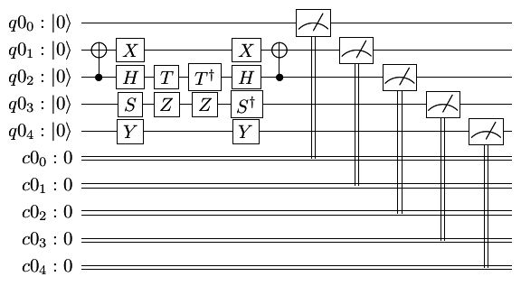
Quantum Circuits

Slide 7
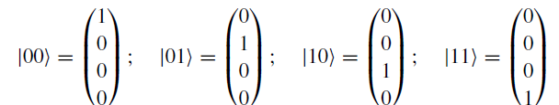
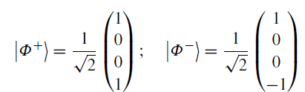
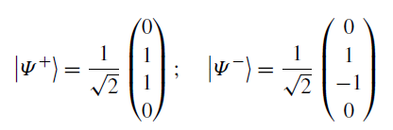
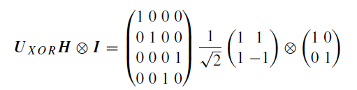
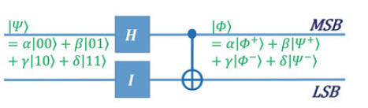
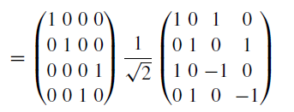
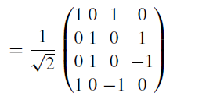
Transform C⁴ Standard Basis
`
Standard basis vectors
Bell states

Slide 8
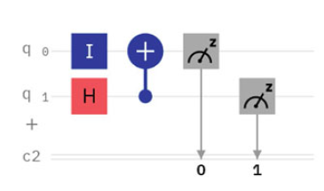
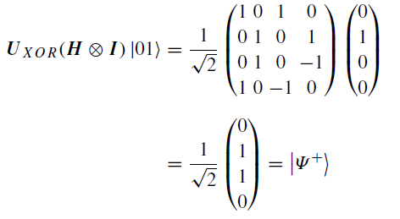

Slide 9
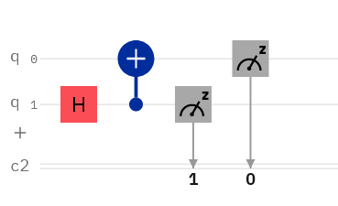
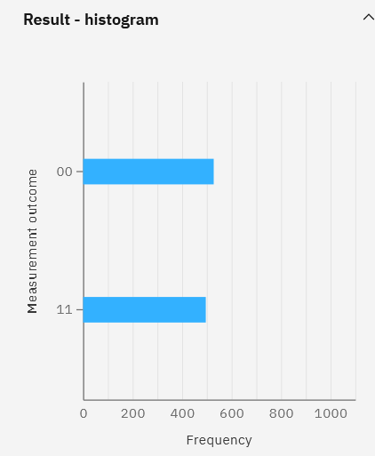
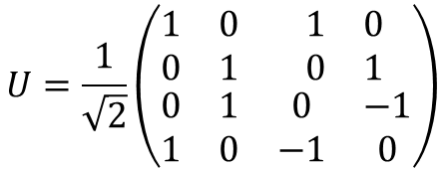
Quantum Circuit in IBM-Q (MSB at the bottom)
$$U=\frac{1}{\sqrt{2}}\left(\begin{matrix}\begin{matrix}1 & 0 \\ 0 & 1\end{matrix} & \begin{matrix}1 & 0 \\ 0 & 1\end{matrix} \\ \begin{matrix}0 & 1 \\ 1 & 0\end{matrix} & \begin{matrix}0 & −1 \\ −1 & 0\end{matrix}\end{matrix}\right)$$
IBM-Q has different location of MSB and LSB than usual.

Slide 10
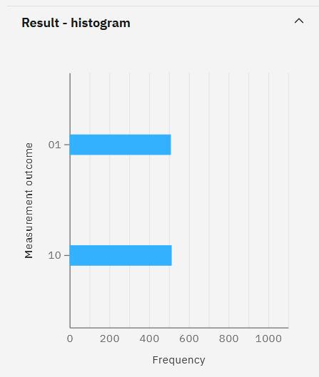
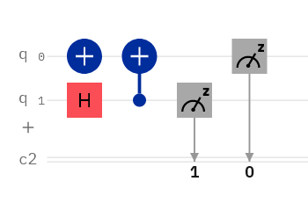
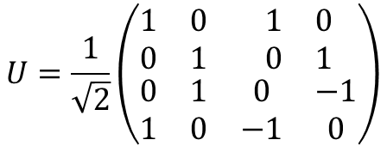
Try one more
$$U=\frac{1}{\sqrt{2}}\left(\begin{matrix}\begin{matrix}1 & 0 \\ 0 & 1\end{matrix} & \begin{matrix}1 & 0 \\ 0 & 1\end{matrix} \\ \begin{matrix}0 & 1 \\ 1 & 0\end{matrix} & \begin{matrix}0 & −1 \\ −1 & 0\end{matrix}\end{matrix}\right)$$

Slide 11
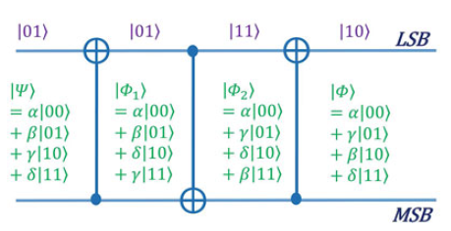
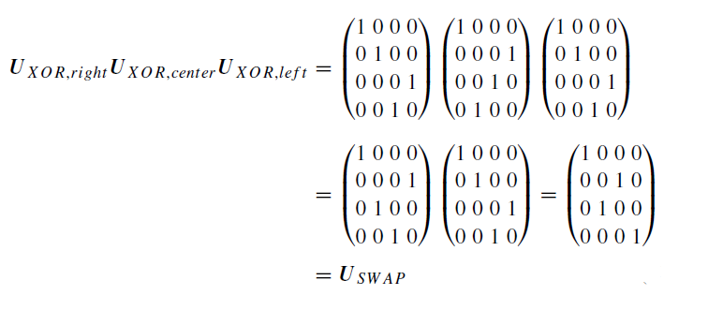
Implementing SWAP gate using XOR

Slide 12
Quantum Teleportation
Transporting a qubit from one location to another without moving physical particle
Non-Cloning Theorem: Need to destroy the original particle
Note: If another particle gets the same state, you cannot distinguish if it is actually the original particle!
So just like teleportation of matter!
E.g. record distance for quantum teleportation is 1,400 km (870 mi) by the group of Jian-Wei Pan using the Micius satellite for space-based quantum teleportation
it is necessary to communicate two classical bits per teleported qubit from the sender to the receiver.

Slide 13
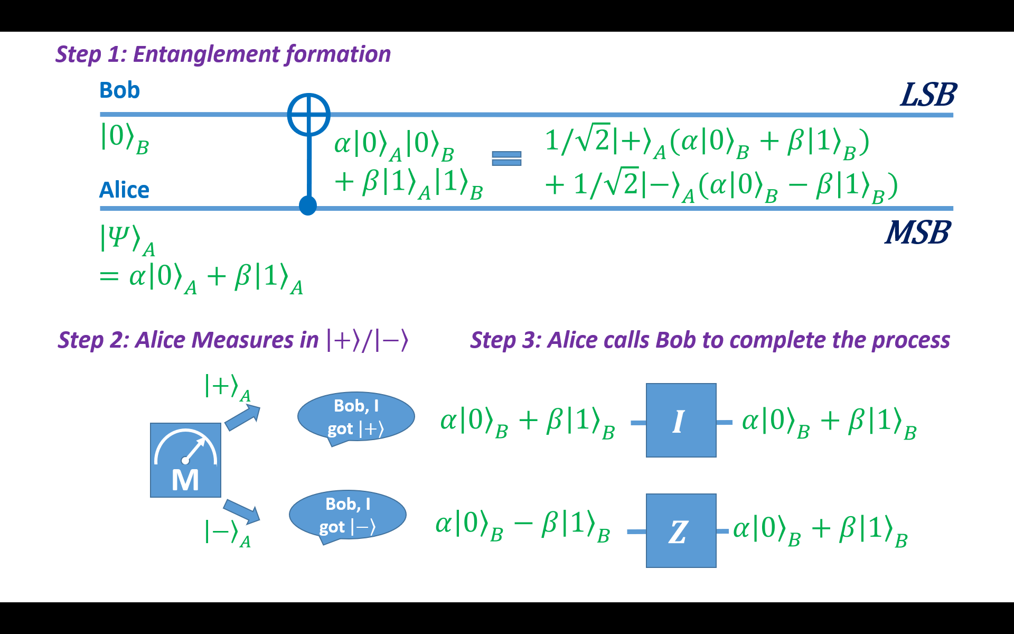


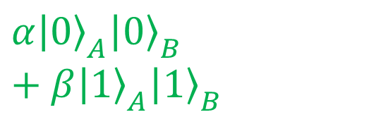
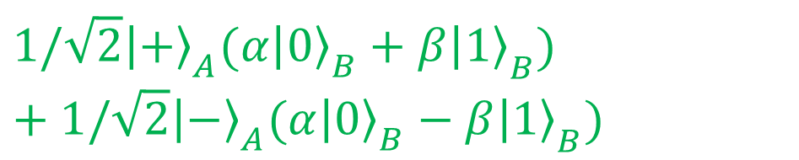

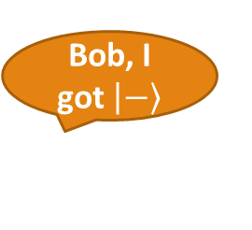










19-1
Step 1: Entanglement formation
Bob
$$⨁$$
LSB
$${\left|\left.0\right\rangle \right.}_{B}$$
$$α{\left|\left.0\right\rangle \right.}_{A}{\left|\left.0\right\rangle \right.}_{B}+β{\left|\left.1\right\rangle \right.}_{A}{\left|\left.1\right\rangle \right.}_{B}$$
$$1/\sqrt{2}{\left|\left.+\right\rangle \right.}_{A}({α\left|\left.0\right\rangle \right.}_{B}+{β\left|\left.1\right\rangle \right.}_{B})+1/\sqrt{2}{\left|\left.−\right\rangle \right.}_{A}({α\left|\left.0\right\rangle \right.}_{B}−{β\left|\left.1\right\rangle \right.}_{B})$$
Alice
$${\left|\left.Ψ\right\rangle \right.}_{A}=α{\left|\left.0\right\rangle \right.}_{A}+β{\left|\left.1\right\rangle \right.}_{A}$$
MSB
Step 2: Alice Measures in $\left|\left.+\right\rangle \right./\left|\left.−\right\rangle \right.$
Step 3: Alice calls Bob to complete the process
$${\left|\left.+\right\rangle \right.}_{A}$$
Bob, I got $\left|\left.+\right\rangle \right.$
$$I$$
$${α\left|\left.0\right\rangle \right.}_{B}+{β\left|\left.1\right\rangle \right.}_{B}$$
$${α\left|\left.0\right\rangle \right.}_{B}+{β\left|\left.1\right\rangle \right.}_{B}$$
M
Bob, I got $\left|\left.−\right\rangle \right.$
$${α\left|\left.0\right\rangle \right.}_{B}−{β\left|\left.1\right\rangle \right.}_{B}$$
$$Z$$
$${\left|\left.−\right\rangle \right.}_{A}$$
$${α\left|\left.0\right\rangle \right.}_{B}+{β\left|\left.1\right\rangle \right.}_{B}$$

Slide 14
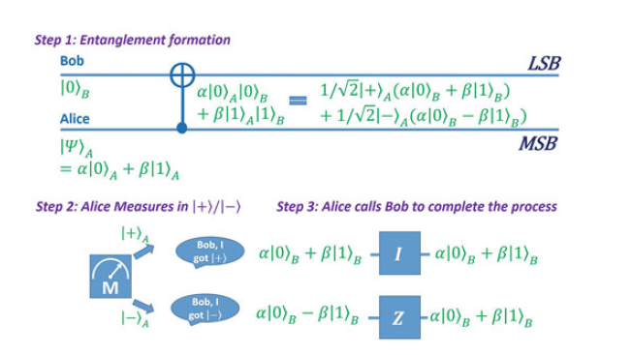
Quantum Teleportation (Basic Idea, not-working example)

Slide 15
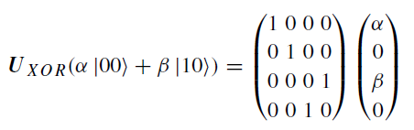
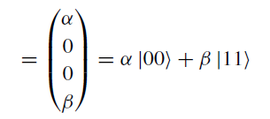
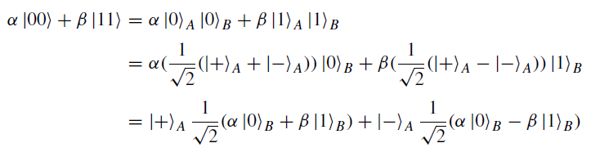
Quantum Teleportation (Basic Idea, not-working example)

Slide 16
Mid-term Review

Slide 17
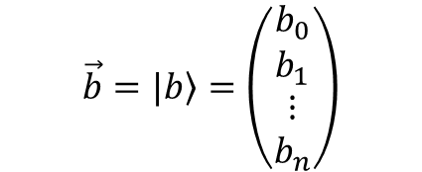
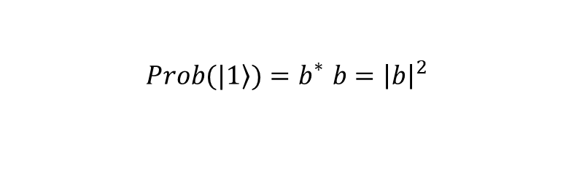
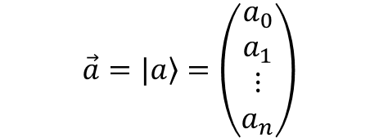
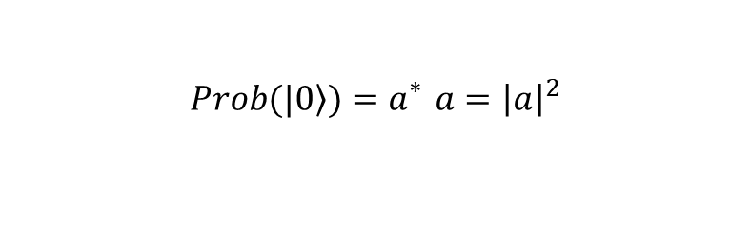
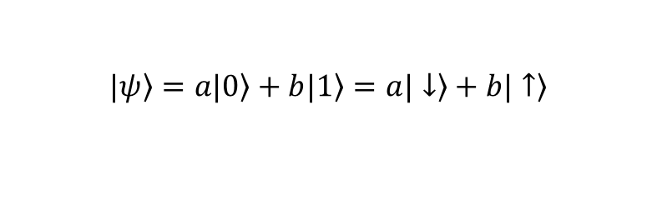
Linear Algebra for Quantum Computing
Inner Product and Bra-Ket notation
$$\vec{a}=|\left.a\right\rangle =\left(\begin{matrix}\begin{matrix}a_{0} \\ a_{1}\end{matrix} \\ \begin{matrix}⋮ \\ a_{n}\end{matrix}\end{matrix}\right)$$
$$\vec{b}=|\left.b\right\rangle =\left(\begin{matrix}\begin{matrix}b_{0} \\ b_{1}\end{matrix} \\ \begin{matrix}⋮ \\ b_{n}\end{matrix}\end{matrix}\right)$$
$$\vec{a}∙\vec{b}=\left\langle a | b\right\rangle =a_{0}^{∗}b_{0}+a_{1}^{∗}b_{1}+…+a_{n}^{∗}b_{n}$$
Superposition
Clarification: spin up and down are the basis and has nothing to do with the unit vector in space (which are the bases of location vector)
$$|\left.ψ\right\rangle =\left.a|0\right\rangle +\left.b|1\right\rangle =\left.a|↓\right\rangle +\left.b|↑\right\rangle$$
Measurement
Wavefunction collapse in measurement. It will collapse to one of the basis in the measurement. The probability is the norm squared of the coefficient.
$$\left.Prob(|0\right\rangle )=a_{}^{∗}a={\left|a\right|}^{2}$$
$$\left.Prob(|1\right\rangle )=b_{}^{∗}b={\left|b\right|}^{2}$$

Slide 18




Linear Algebra for Quantum Computing
Orthonormal Basis
Normalized Vector
Question: Do we need orthonormal basis in quantum computing? Yes, in order to make the measurement result meaningful (unambiguous).
Orthogonal
$\left\langle b_{i} | b_{j}\right\rangle =0$ if $i≠j$
$\left\langle b_{i} | b_{j}\right\rangle =1$ if $i=j$
Orthonormal
$$|\left.ψ\right\rangle =\left(\begin{matrix}\begin{matrix}a_{0} \\ a_{1}\end{matrix} \\ \begin{matrix}⋮ \\ a_{n}\end{matrix}\end{matrix}\right)$$
$$\left\langle ψ | ψ\right\rangle =a_{0}^{∗}a_{0}+a_{1}^{∗}a_{1}+…+a_{n}^{∗}a_{n}=1$$

Slide 19
Linear Algebra for Quantum Computing
Change of Basis Example
$$|\left.0\right\rangle =\frac{1}{\sqrt{2}}(\left.|+\right\rangle +\left.|−\right\rangle )$$
$$|\left.1\right\rangle =\frac{1}{\sqrt{2}}(\left.|+\right\rangle −\left.|−\right\rangle )$$
$$|\left.ψ\right\rangle =\left.a|0\right\rangle +\left.b|1\right\rangle$$
$$|\left.ψ\right\rangle =\frac{1}{\sqrt{2}}((a+b)\left.|+\right\rangle +\left.(a−b)|−\right\rangle )$$
Bra-Ket Dual Correspondence
$$\left\langle a|\right.$$
$$\left.|a\right\rangle$$
$$c^{∗}\left\langle a|\right.$$
$$\left.c|a\right\rangle$$
$$c_{a}^{∗}\left\langle a|\right.+c_{b}^{∗}\left\langle b|\right.$$
$$\left.c_{a}|a\right\rangle +\left.c_{b}|b\right\rangle$$
Bra-Ket Equations
$\left\langle a | b\right\rangle$=${\left\langle b | a\right\rangle }^{∗}$

Slide 20
Linear Algebra for Quantum Computing
How to normalize a vector (typo in the last lecture slide)
Observables are represented by Operators. Each operator has its set of eigenvector and eigenvalues
Pauli-Spin Matrices
They are anti-commute
$\left\{σ_{i},σ_{j}\right\}=σ_{i}σ_{j}+σ_{j}σ_{i}=2δ_{ij}I$
Always ask yourselves, is this a complex number, vector or matrix.
$\left.|a\right\rangle =\frac{\left.|\tilde{a}\right\rangle }{\sqrt{\left\langle \tilde{a} | \tilde{a}\right\rangle }}$
$$σ_{x}=\left(\begin{matrix}0 & 1 \\ 1 & 0\end{matrix}\right)$$
$$σ_{y}=\left(\begin{matrix}0 & −i \\ i & 0\end{matrix}\right)$$
$$σ_{z}=\left(\begin{matrix}1 & 0 \\ 0 & −1\end{matrix}\right)$$

Slide 21
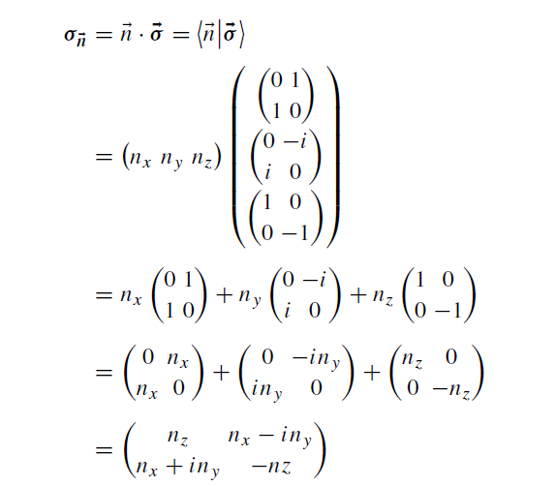
Linear Algebra for Quantum Computing
Spin Matrix in Arbitrary Direction
$$\overset{⃑}{n}∙\overset{⃑}{σ}$$
Are you able to write down what it mean in matrix form?
Adjoint
$$A^{†}=A^{T∗}$$
Self-Adjoint (Hermitian) Matrices, real eigenvalues
$$A^{†}=A$$

Slide 22
Linear Algebra for Quantum Computing
More Operator, Bra-Ket Equations and Relationships
Matrix Diagonalization
$$X\left(\left.|a\right\rangle \right)=X\left.|a\right\rangle$$
$X=Y$ iff $X\left.|a\right\rangle =Y\left.|a\right\rangle$
Null operator: $X\left.|a\right\rangle =\left.|0\right\rangle$
$$X\left(\left.c_{a}|a\right\rangle +\left.c_{b}|b\right\rangle \right)=c_{a}X\left.|a\right\rangle +c_{b}X\left.|b\right\rangle$$
$$X\left.|a\right\rangle$$
$${\left\langle a| \right.X}^{†}$$
$$\left\langle a | X | b\right\rangle ={\left\langle b | X^{†} | a\right\rangle }^{∗}$$
$$X\left.|a\right\rangle =\left.a|a\right\rangle$$
$$\left(X−aI\right)\left.|a\right\rangle =0$$
$$\left|X−aI\right|=0$$

Slide 23

Linear Algebra for Quantum Computing
Matrix representation in different basis
$$σ_{x}=\left(\begin{matrix}0 & 1 \\ 1 & 0\end{matrix}\right)$$
In $σ_{Z}$ eigen-vector basis
$$σ_{x}=\left(\begin{matrix}1 & 0 \\ 0 & −1\end{matrix}\right)$$
In $σ_{x}$ eigen-vector basis
Diagonal!
Unitary Matrix
$${U^{†}U}^{−1}=U^{−1}U^{†}=I$$
$\left\langle f | g\right\rangle$=$\left\langle Uf | Ug\right\rangle$
Inner product conserved
$$U=\left(\begin{matrix}\overset{⃑}{u_{0}} & ⋯ & \overset{⃑}{u_{n}}\end{matrix}\right), \left\langle u_{i} | u_{j}\right\rangle =δ_{ij}$$
Construction of Unitary Transformation Matrix
$$\left(\begin{matrix}\left\langle a_{1}^{new} | a_{1}^{old}\right\rangle & ⋯ & \left\langle a_{1}^{new} | a_{n}^{old}\right\rangle \\ ⋮ & ⋮ & ⋮ \\ \left\langle a_{n}^{new} | a_{1}^{old}\right\rangle & ⋯ & \left\langle a_{n}^{new} | a_{n}^{old}\right\rangle \end{matrix} \right)$$
$$a_{i}^{new}$$
$$a_{i}^{old}$$
: Old basis
: New basis

Slide 24
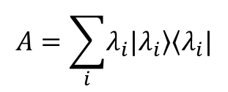
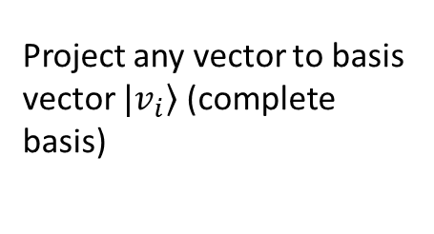
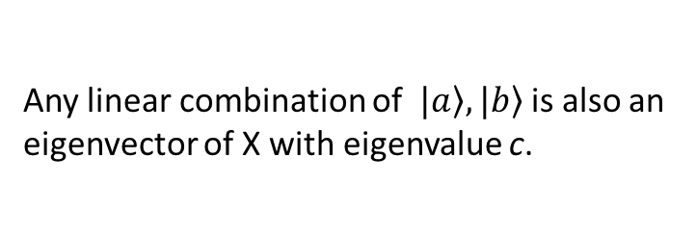
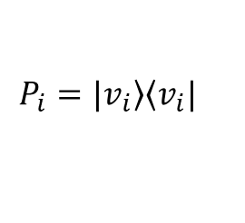
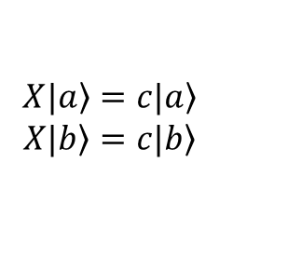
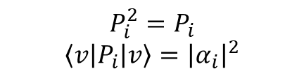

Linear Algebra for Quantum Computing
Projection Operator/ Projector
$$P_{i}=\left.|v_{i}\right\rangle \left\langle v_{i}|\right.$$
Project any vector to basis vector $\left.|v_{i}\right\rangle$ (complete basis)
$$P_{i}^{2}=P_{i}$$
$$\left\langle v | P_{i} | v\right\rangle ={\left|α_{i}\right|}^{2}$$
Degeneracy
$$X\left.|a\right\rangle =\left.c|a\right\rangle$$
$$X\left.|b\right\rangle =\left.c|b\right\rangle$$
If $\left.|a\right\rangle ≠\left.|b\right\rangle$, they are degenerated (Same eigen value, c.
Any linear combination of $\left.|a\right\rangle ,\left.|b\right\rangle$ is also an eigenvector of X with eigenvalue c.
Construction of operator from given eigenvalues and eigenvectors
$$A=\sum_{i}{\left.λ_{i}|λ_{i}\right\rangle \left\langle λ_{i}|\right.}$$

Slide 25


Linear Algebra for Quantum Computing
Hilbert Space (Physics convention)
A complete linear space with inner product obey:
$\left\langle f | f\right\rangle$≥0
$\left\langle cf | g\right\rangle$=$c^{∗}\left\langle f | g\right\rangle$
$\left\langle f | g\right\rangle$=${\left\langle g | f\right\rangle }^{∗}$
$\left\langle f+h | g\right\rangle$=$\left\langle f | g\right\rangle +\left\langle h | g\right\rangle$
Tensor Product of Hilbert Spaces
$$H_{3}=H_{1}⊗H_{2}$$
$$h=\sum_{j=1}^{n}{f_{j}⊗g_{j}}$$
$$\left\langle \sum_{j=1}^{n_{1}}{f_{j}⊗g_{j}} | \sum_{l=1}^{n_{2}}{h_{l}⊗k_{l}}\right\rangle =\sum_{j=1}^{n_{1}}{\sum_{l=1}^{n_{2}}{\left\langle f_{j} | h_{l}\right\rangle \left\langle g_{j} | k_{l}\right\rangle }}$$
Any finite sum

Slide 26
Linear Algebra for Quantum Computing
Tensor Product of Vectors and Matrix
$$\left(\begin{matrix}a_{11} & ⋯ & a_{1n} \\ ⋮ & & ⋮ \\ a_{n1} & ⋯ & a_{nn}\end{matrix}\right)⊗\left(\begin{matrix}b_{11} & ⋯ & b_{1n} \\ ⋮ & & ⋮ \\ b_{n1} & ⋯ & b_{nn}\end{matrix}\right)$$
$$=\left(\begin{matrix}a_{11}\left(\begin{matrix}b_{11} & ⋯ & b_{1n} \\ ⋮ & & ⋮ \\ b_{n1} & ⋯ & b_{nn}\end{matrix}\right) & ⋯ & a_{1n}\left(\begin{matrix}b_{11} & ⋯ & b_{1n} \\ ⋮ & & ⋮ \\ b_{n1} & ⋯ & b_{nn}\end{matrix}\right) \\ ⋮ & & ⋮ \\ a_{n1}\left(\begin{matrix}b_{11} & ⋯ & b_{1n} \\ ⋮ & & ⋮ \\ b_{n1} & ⋯ & b_{nn}\end{matrix}\right) & ⋯ & a_{nn}\left(\begin{matrix}b_{11} & ⋯ & b_{1n} \\ ⋮ & & ⋮ \\ b_{n1} & ⋯ & b_{nn}\end{matrix}\right)\end{matrix}\right)$$
$$=\left(\begin{matrix}a_{11}b_{11} & ⋯ & a_{1n}b_{1n} \\ ⋮ & & ⋮ \\ a_{n1}b_{n1} & ⋯ & a_{nn}b_{nn}\end{matrix}\right)$$
$$\left.|f\right\rangle =\sum_{i=1}^{n}{f_{i}\left.|v_{i}\right\rangle \left. |g\right\rangle =\sum_{j=1}^{m}{g_{j}\left.|u_{j}\right\rangle }}$$
$$\left.|h\right\rangle =\left.|f\right\rangle ⊗\left.|g\right\rangle =\sum_{i=1}^{n}{\sum_{i=1}^{m}{f_{i}\left.g_{j}|v_{i}\right\rangle ⊗\left.|u_{j}\right\rangle }}=\sum_{i=1}^{n}{\sum_{i=1}^{m}{f_{i}\left.g_{j}|v_{i}\right\rangle \left.|u_{j}\right\rangle }}$$
Partial Measurement
Matrix Representation in a Given Basis
$$H_{ij}=\left\langle v_{i} | H | v_{j}\right\rangle$$

Slide 27
Linear Algebra for Quantum Computing
Quantum Register: Collection of qubits, tensor product of C² space.
$$\left\langle a | b\right\rangle =\left\langle a_{n−1}a_{n−2}⋯a_{0} | b_{n−1}b_{n−2}⋯b_{0}\right\rangle =\left\langle a_{n−1} | b_{n−1}\right\rangle \left\langle a_{n−2} | b_{n−2}\right\rangle ⋯\left\langle a_{0} | b_{0}\right\rangle$$
Under what condition who it be orthogonal?
A general vector can be a linear combination of the quantum registers
$$|\left.ψ\right\rangle =\left.a|0\right\rangle +\left.b|1\right\rangle$$
1-qubit case
$$|\left.ψ\right\rangle =\left.a|0\right\rangle +\left.b|1\right\rangle +\left.c|2\right\rangle +\left.d|3\right\rangle$$
2-qubit case
$$Φ^{+}=\frac{1}{\sqrt{2}}\left(\begin{matrix}\begin{matrix}1 \\ 0\end{matrix} \\ \begin{matrix}0 \\ 1\end{matrix}\end{matrix}\right) Φ^{−}=\frac{1}{\sqrt{2}}\left(\begin{matrix}\begin{matrix}1 \\ 0\end{matrix} \\ \begin{matrix}0 \\ −1\end{matrix}\end{matrix}\right)$$
$$ψ^{+}=\frac{1}{\sqrt{2}}\left(\begin{matrix}\begin{matrix}0 \\ 1\end{matrix} \\ \begin{matrix}1 \\ 0\end{matrix}\end{matrix}\right) ψ^{−}=\frac{1}{\sqrt{2}}\left(\begin{matrix}\begin{matrix}0 \\ 1\end{matrix} \\ \begin{matrix}−1 \\ 0\end{matrix}\end{matrix}\right)$$
Bell States
Entanglement
$$|\left.ψ\right\rangle ≠|\left.ψ_{1}\right\rangle ⊗|\left.ψ_{2}\right\rangle$$

Slide 28











Linear Algebra for Quantum Computing
Unitary gate are reversible
Evolution matrix from Schroedinger Equation is unitary
$$U=e^{−\frac{iHt}{ħ}}$$
Various type of quantum gates
SWAP Gate
NOT/ X Gate
XOR/ CNOT Gate
$$X=\left(\begin{matrix}0 & 1 \\ 1 & 0\end{matrix}\right)$$
$$S=\left(\begin{matrix}\begin{matrix}1 & 0 \\ 0 & 0\end{matrix} & \begin{matrix}0 & 0 \\ 1 & 0\end{matrix} \\ \begin{matrix}0 & 1 \\ 0 & 0\end{matrix} & \begin{matrix}0 & 0 \\ 0 & 1\end{matrix}\end{matrix}\right)$$
$$U_{XOR}=\left(\begin{matrix}\begin{matrix}1 & 0 \\ 0 & 1\end{matrix} & \begin{matrix}0 & 0 \\ 0 & 0\end{matrix} \\ \begin{matrix}0 & 0 \\ 0 & 0\end{matrix} & \begin{matrix}0 & 1 \\ 1 & 0\end{matrix}\end{matrix}\right)$$
$$X=\left(\begin{matrix}\begin{matrix}0 & 0 \\ 0 & 0\end{matrix} & \begin{matrix}0 & 1 \\ 1 & 0\end{matrix} \\ \begin{matrix}0 & 1 \\ 1 & 0\end{matrix} & \begin{matrix}0 & 0 \\ 0 & 0\end{matrix}\end{matrix}\right)$$
$$U_{XOR}|\left.ab\right\rangle =\left.|a,a⨁b\right\rangle$$
$$S|\left.a,b\right\rangle =\left.|b,a\right\rangle$$
$$X|\left.a\right\rangle =\left.|\overline{a}\right\rangle$$
$$X|\left.a,b\right\rangle =\left.|\overline{a}\overline{,b}\right\rangle$$

Slide 29
Linear Algebra for Quantum Computing
More discussion on EPR Paradox: Either QM is incomplete or information can be transmitted faster than light
Transform matrix between bases:
More about Trace:
$$X_{new}=UX_{old}U^{†}$$
$$Tr(AB)=Tr(BA)$$
1-bit Phase Shift Gate
2-bit Phase Shift Gate
More quantum gates
$$X=\left(\begin{matrix}1 & 0 \\ 0 & e^{iφ}\end{matrix}\right)$$
$$U_{PS}(φ)=\left(\begin{matrix}\begin{matrix}1 & 0 \\ 0 & 1\end{matrix} & \begin{matrix}0 & 0 \\ 0 & 0\end{matrix} \\ \begin{matrix}0 & 0 \\ 0 & 0\end{matrix} & \begin{matrix}1 & 0 \\ 0 & e^{iφ}\end{matrix}\end{matrix}\right)$$
$$X(φ=π)=Z$$
Btw, Z gate in |0>|1> basis is just the NOT (X) gate in |+>|-> basis
$$U_{PS}|\left.ab\right\rangle =\left.e^{ia⋅bφ}|ab\right\rangle$$

Slide 30

Linear Algebra for Quantum Computing
Toffoli (CCNOT) Gate
A universal gate for classical gate
In strict sense, there is NO universal quantum gate
Hadamard (H) Gate
No classical counterpart
$$H|\left.0\right\rangle =\frac{1}{\sqrt{2}}(\left.|0\right\rangle +\left.|1\right\rangle )$$
$$CCNOT|\left.a,b,c\right\rangle =\left.|a,b,(a∙b)⨁c\right\rangle$$
$$H|\left.1\right\rangle =\frac{1}{\sqrt{2}}(\left.|0\right\rangle −\left.|1\right\rangle )$$
$$CCNOT=\left(\begin{matrix}\begin{matrix}\begin{matrix}1 & 0 \\ 0 & 1\end{matrix} & \begin{matrix}0 & 0 \\ 0 & 0\end{matrix} \\ \begin{matrix}0 & 0 \\ 0 & 0\end{matrix} & \begin{matrix}1 & 0 \\ 0 & 1\end{matrix}\end{matrix} & \begin{matrix}\begin{matrix}0 & 0 \\ 0 & 0\end{matrix} & \begin{matrix}0 & 0 \\ 0 & 0\end{matrix} \\ \begin{matrix}0 & 0 \\ 0 & 0\end{matrix} & \begin{matrix}0 & 0 \\ 0 & 0\end{matrix}\end{matrix} \\ \begin{matrix}\begin{matrix}0 & 0 \\ 0 & 0\end{matrix} & \begin{matrix}0 & 0 \\ 0 & 0\end{matrix} \\ \begin{matrix}0 & 0 \\ 0 & 0\end{matrix} & \begin{matrix}0 & 0 \\ 0 & 0\end{matrix}\end{matrix} & \begin{matrix}\begin{matrix}1 & 0 \\ 0 & 1\end{matrix} & \begin{matrix}0 & 0 \\ 0 & 0\end{matrix} \\ \begin{matrix}0 & 0 \\ 0 & 0\end{matrix} & \begin{matrix}0 & 1 \\ 1 & 0\end{matrix}\end{matrix}\end{matrix}\right)$$
$$H=\frac{1}{\sqrt{2}}\left(\begin{matrix}1 & 1 \\ 1 & −1\end{matrix}\right)$$
$$H=H^{−1}$$
$$H_{n}|\left.0\right\rangle =\frac{1}{2^{\frac{n}{2}}}\sum_{x=0}^{2^{n}−1}{\left.|x\right\rangle }$$

Slide 31
Linear Algebra for Quantum Computing
Hadamard (H) Gate
No classical counterpart
$$H|\left.0\right\rangle =\frac{1}{\sqrt{2}}(\left.|0\right\rangle +\left.|1\right\rangle )$$
$$H|\left.1\right\rangle =\frac{1}{\sqrt{2}}(\left.|0\right\rangle −\left.|1\right\rangle )$$
$$H=\frac{1}{\sqrt{2}}\left(\begin{matrix}1 & 1 \\ 1 & −1\end{matrix}\right)$$
$$H=H^{−1}$$
$$H_{n}|\left.0\right\rangle =\frac{1}{2^{\frac{n}{2}}}\sum_{x=0}^{2^{n}−1}{\left.|x\right\rangle }$$
$$H_{n}|\left.y\right\rangle =\frac{1}{2^{\frac{n}{2}}}\sum_{x=0}^{2^{n}−1}{\left.{(−1)}^{x∙y}|x\right\rangle }$$

